Slide 1
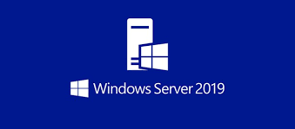

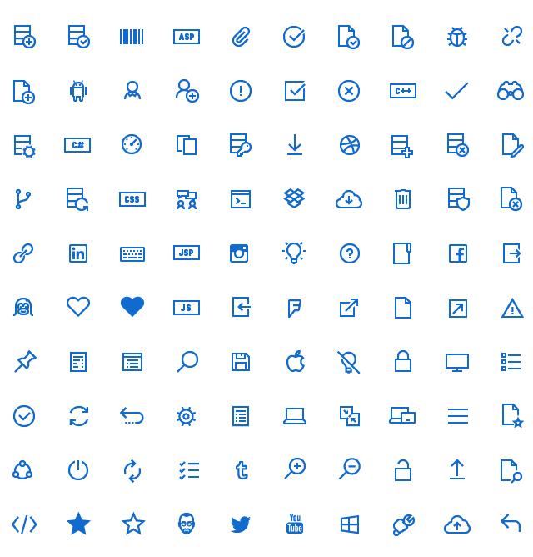


FILE SERVER
BOAS PRÁTICAS
ADMINISTRAÇÃO
www.eduardopopovici.com
EDUARDO POPOVICI

Slide 2

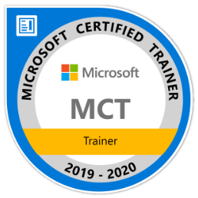

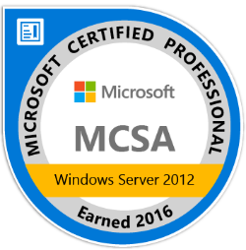
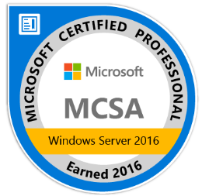
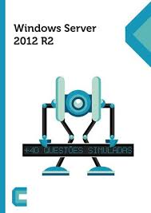
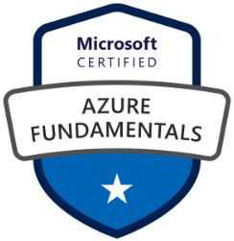
Instrutor
Certificações:
MCSE, MCSA, MTA, MCTS, MTA, Azure
6sigma – Green Belt e Agile Scrum Foundation
Graduações e pós:
Pós graduação em gerenciamento de projetos - Práticas do PMI [SENAC]
Pós graduação em educação transformadora, pedagogia, fundamentos e práticas [PUCRS]
Pós graduação em cyber security [Faculdade Impacta - Daryus]
MBA em projeto e gerenciamento de data center [Faculdade Impacta]
MBA em arquitetura de redes e cloud computing [FIAP]
MBA em planejamento e estratégia de negócios com suporte da TI
Graduação em redes de computadores [Faculdade Módulo Paulista]
Linkedin: https://www.linkedin.com/in/edupopovhtbraz/
Blog: www.eduardopopovici.com
Livro: https://www.juliobattisti.com.br/loja/detalheproduto.asp?CodigoLivro=LIV0001438

Slide 3
FILE SERVER
BOAS PRÁTICAS
ADMINISTRAÇÃO
www.eduardopopovici.com
EDUARDO POPOVICI

Slide 4
CERTIFICAÇÕES
Conceitos
Notes:
https://www.microsoft.com/pt-br/learning/certification-overview.aspx

Slide 5


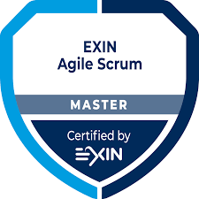


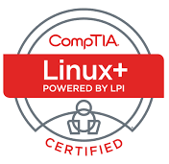


Certificações
https://www.microsoft.com/pt-br/learning/certification-overview.aspx

Slide 6
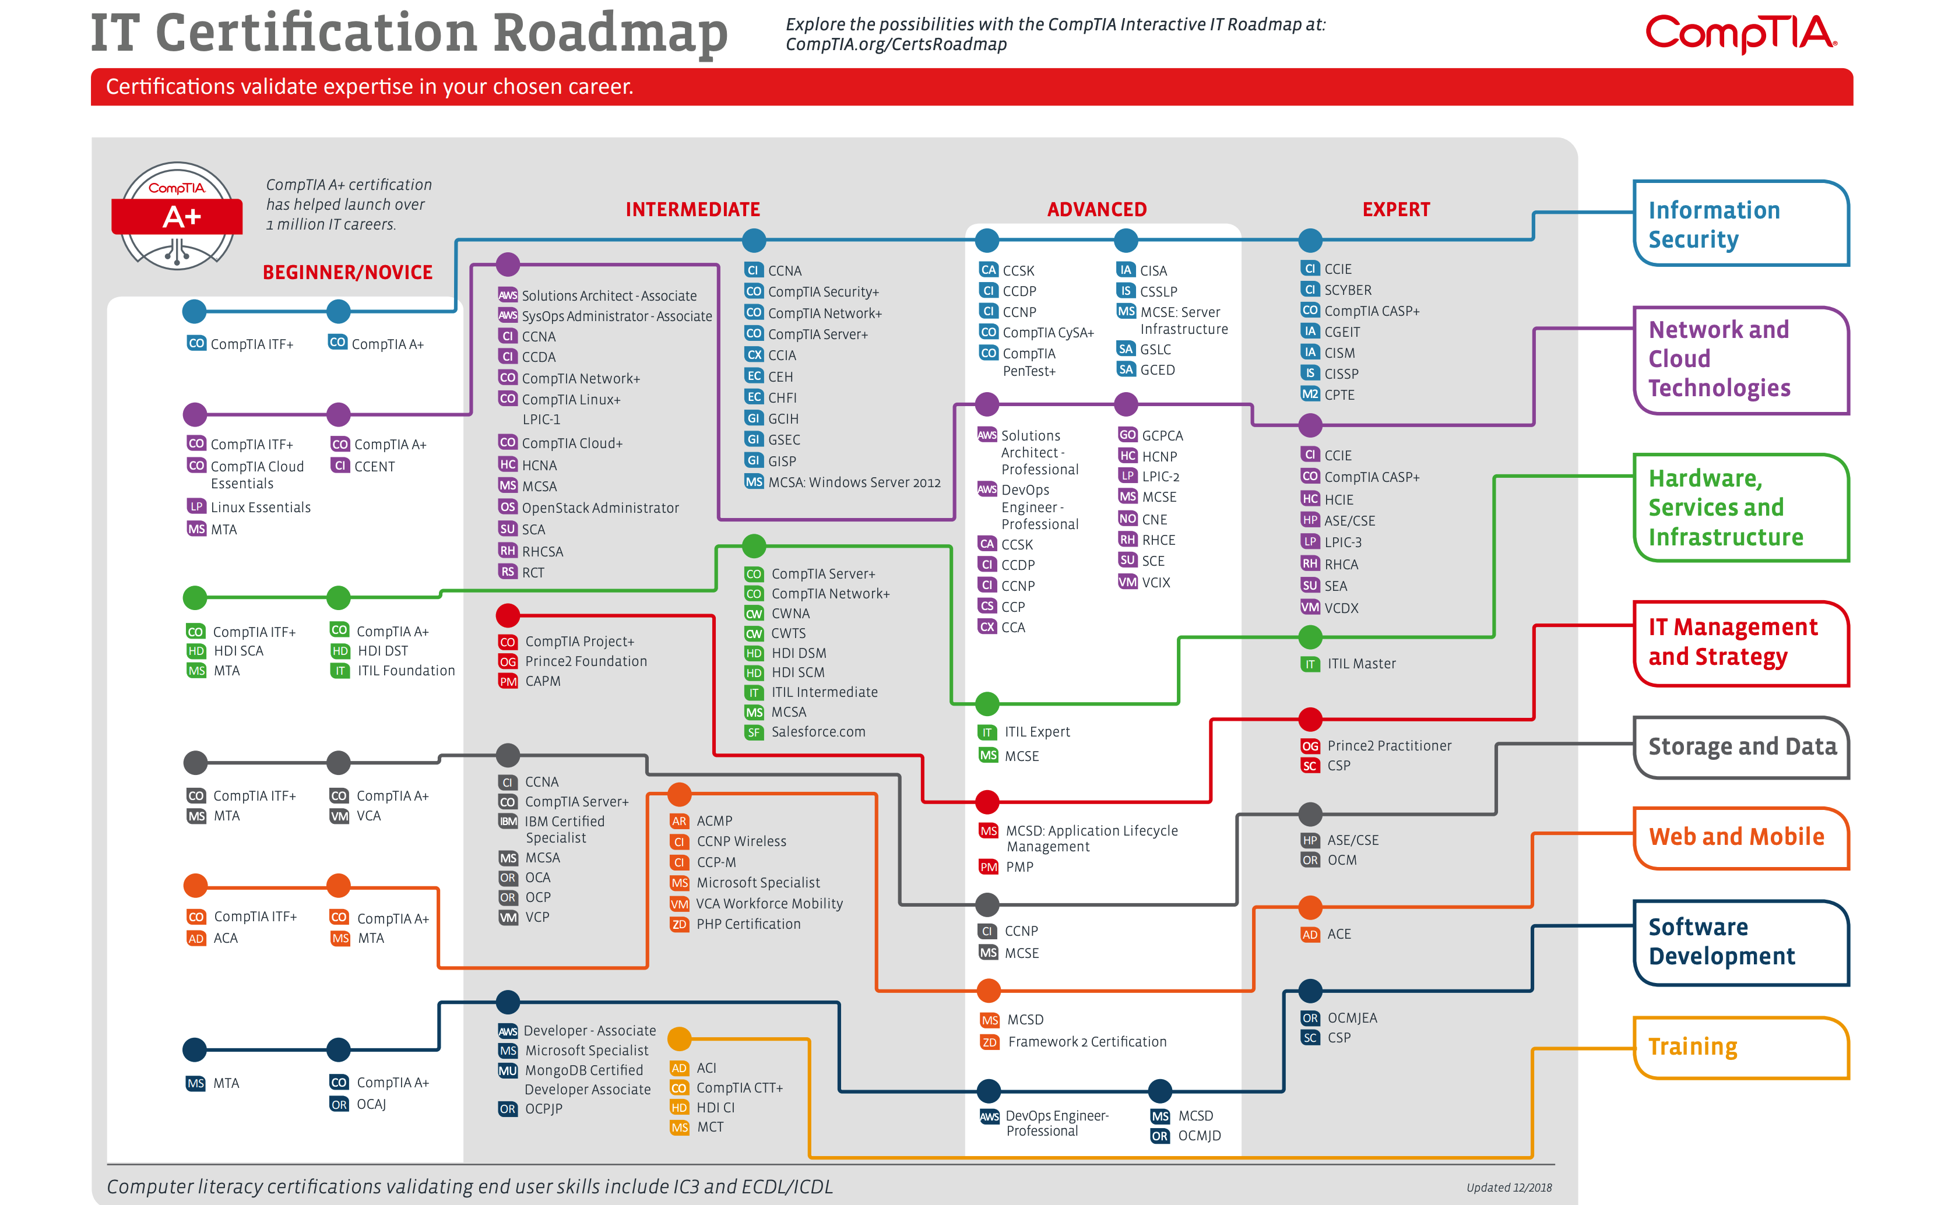

Slide 7

Microsoft training and certifications

Slide 8
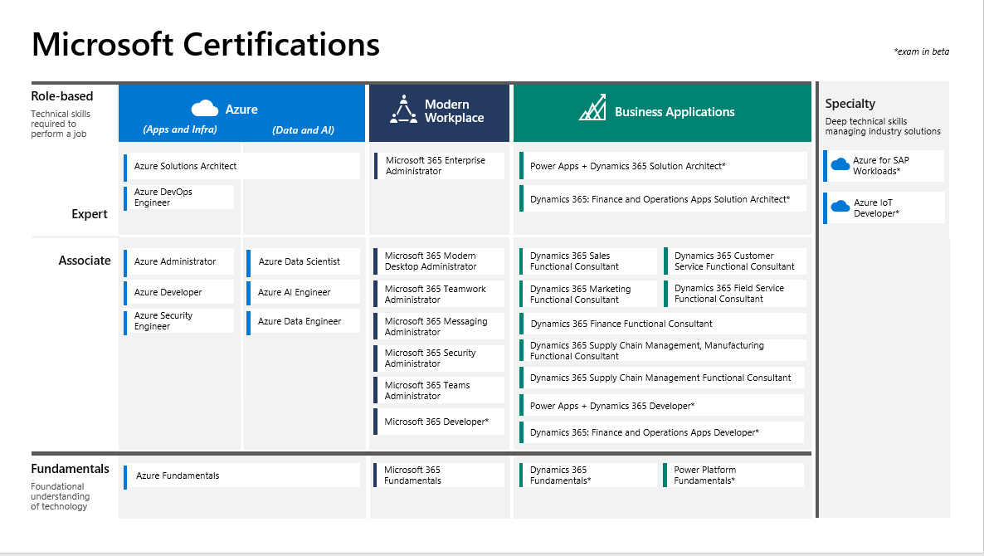
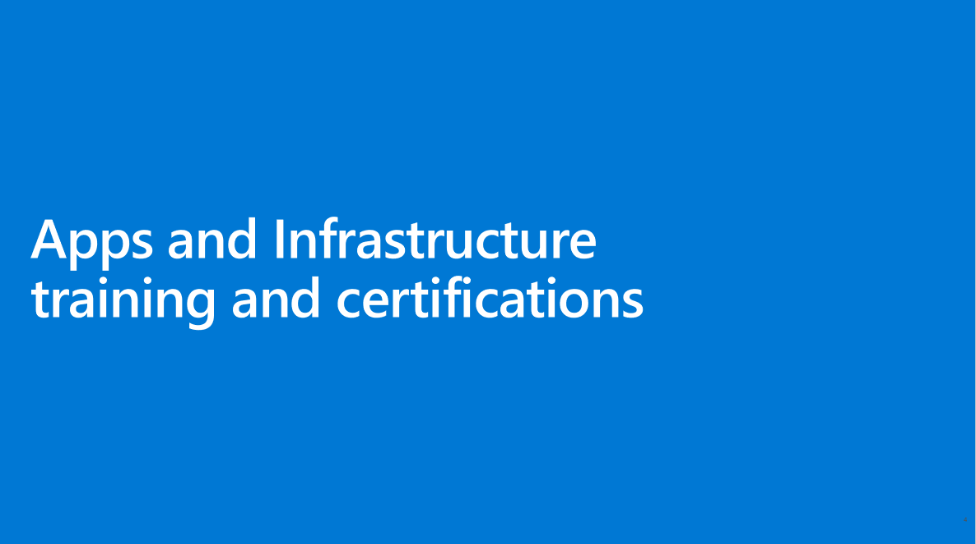
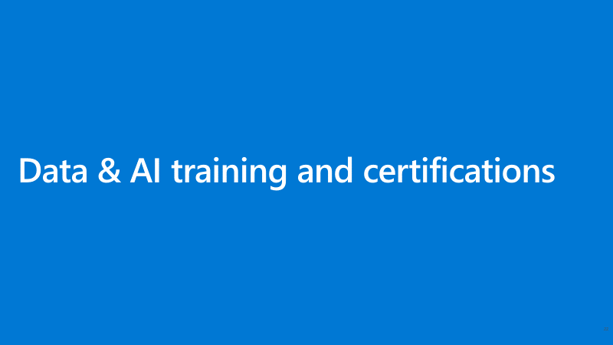
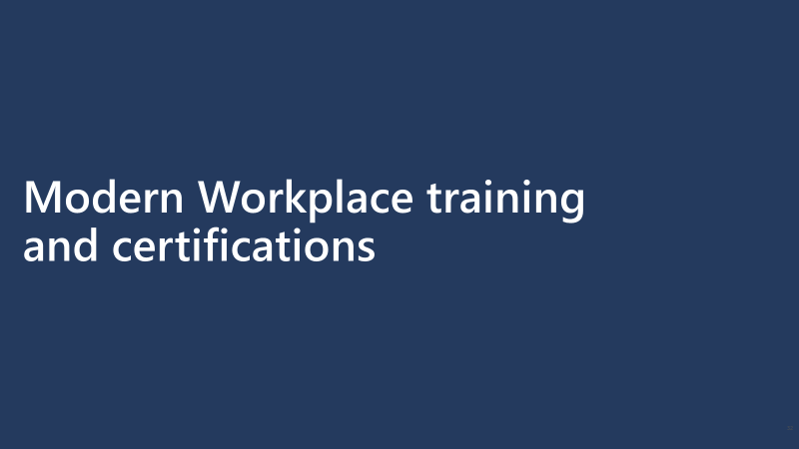
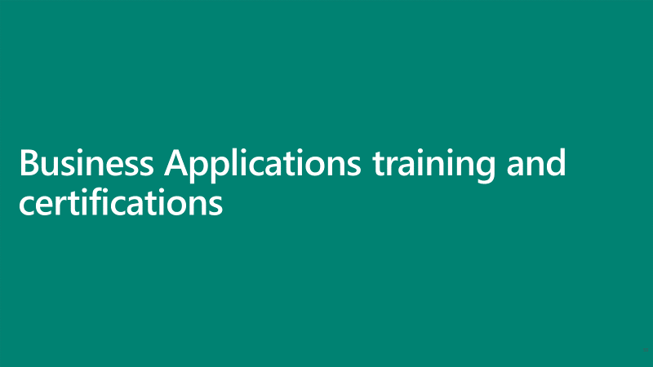
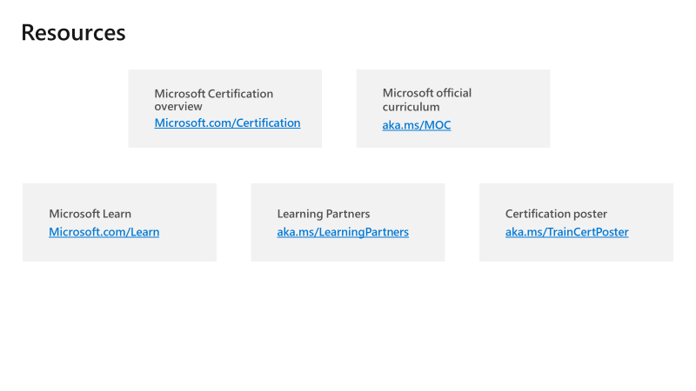
Table of contents
3
4
24
Microsoft training and certifications
Apps and Infrastructure
Data and AI
34
55
85
Modern Workplace
Business Applications
Resources

Slide 9

Microsoft Certifications
Last updated: Feb 4, 2020 *exam in beta
Role-based
Technical skills required to perform a job
Modern Workplace
Specialty
Deep technical skills managing industry solutions
Azure
Business Applications
(Apps and Infra)
(Data and AI)
Azure Solutions Architect
Microsoft 365 Enterprise Administrator
Power Apps + Dynamics 365 Solution Architect*
Azure for SAP Workloads*
Azure DevOps Engineer
Dynamics 365: Finance and Operations Apps Solution Architect*
Azure IoT Developer*
Expert
Associate
Azure Administrator
Azure Data Scientist
Microsoft 365 Modern Desktop Administrator
Dynamics 365 Sales Functional Consultant
Dynamics 365 Customer Service Functional Consultant
Azure Developer
Azure AI Engineer
Microsoft 365 Teamwork Administrator
Dynamics 365 Marketing Functional Consultant
Dynamics 365 Field Service Functional Consultant
Azure Security Engineer
Azure Data Engineer
Microsoft 365 Messaging Administrator
Dynamics 365 Finance Functional Consultant
Microsoft 365 Security Administrator
Dynamics 365 Supply Chain Management, Manufacturing Functional Consultant
Microsoft 365 Teams Administrator
Dynamics 365 Supply Chain Management Functional Consultant
Power Apps + Dynamics 365 Developer*
Microsoft 365 Developer*
Dynamics 365: Finance and Operations Apps Developer*
Fundamentals
Foundational understanding of technology
Azure Fundamentals
Microsoft 365 Fundamentals
Dynamics 365 Fundamentals*
Power Platform Fundamentals*
Notes:
These are the certifications we have released to meet market needs.
All our certifications prove that a person has the skills to help organizations maximize the capabilities of the cloud to achieve desired business outcomes.
We update our certifications regularly to reflect the change of pace of business and technology. Our certifications remain technically accurate and relevant, with updates occurring every two months, and additional roles and specialties added as the market requires.
So, how do you leverage all the resources available and set your team on a learning journey?

Slide 10
Apps and Infrastructure training and certifications

Slide 11
Azure certifications
Last updated: Feb 4, 2020 *exam in beta
Role-based
Technical skills required to perform a job
Specialty
Deep technical skills managing industry solutions
Apps and Infra
Data and AI
Azure Solutions Architect
Azure for SAP Workloads*
Azure DevOps Engineer
Azure IoT Developer*
Expert
Associate
Azure Administrator
Azure Data Scientist
Azure Developer
Azure AI Engineer
Azure Security Engineer
Azure Data Engineer
Fundamentals
Foundational understanding of technology
Azure Fundamentals
Notes:
These are the certifications we have released to meet market needs.
All our certifications prove that a person has the skills to help organizations maximize the capabilities of the cloud to achieve desired business outcomes.
We update our certifications regularly to reflect the change of pace of business and technology. Our certifications remain technically accurate and relevant, with updates occurring every two months, and additional roles and specialties added as the market requires.
So, how do you leverage all the resources available and set your team on a learning journey?

Slide 12
Azure Apps and Infrastructure certifications
Fundamentals
Role-based
Specialty
Associate
Expert
Microsoft Certified: Azure Administrator Associate
Microsoft Certified: Azure for SAP Workloads Specialty*
OR
Microsoft Certified: Azure DevOps Engineer Expert
Microsoft Certified: Azure IoT Developer Specialty*
Microsoft Certified: Azure Fundamentals (Optional)
Microsoft Certified: Azure Developer Associate
Microsoft Certified: Azure Security Engineer Associate
Diagram Key
Optional Path
Microsoft Certified: Azure Solutions Architect Expert
Required Path
*
Exam in beta

Slide 13
Learning path for Azure Fundamentals
Skills required for certification
Exams
Certification
AZ-900: Microsoft Azure Fundamentals
Cloud concepts
Core Azure services
Online courses and instructor-led training available to support learning
Microsoft Certified: Azure Fundamentals
Start here
Security, privacy, compliance, and trust
Azure pricing and support

Slide 14
Course details for Azure Fundamentals
2 Instructor-led training courses
Exam titles | Course title / training titles | Course ID | Course duration
Microsoft Azure Fundamentals EXAM AZ-900 | Microsoft Azure Fundamentals | AZ-900T00 | 2 Days
 | Microsoft Azure Fundamentals | AZ-900T01 | 1 Day

Slide 15
Learning path for Azure Administrator Associate
Skills required for certification
Exams
Certification
Azure subscriptions
& resources
Storage solutions
AZ-103: Microsoft Azure Administrator
Online courses and instructor-led training available to support learning
Microsoft Certified: Azure Administrator Associate
Start here
Virtual machines
Virtual networks
Identity management

Slide 16
Course details for Azure Administrator Associate
1 Instructor-led training course
Exam titles | Course title / training titles | Course ID | Course duration
Microsoft Azure Administrator EXAM AZ-103 | Microsoft Azure Administrator | AZ-103T00 | 4 Days

Slide 17
Learning path for Azure Developer Associate
Skills required for certification
Exams
Certification
Azure Infrastructure as a Service compute solutions
Monitor, troubleshoot, and optimize solutions
AZ-203: Developing Solutions for Microsoft Azure
Azure storage
Online courses and instructor-led training available to support learning
Microsoft Certified: Azure Developer Associate
Start here
Azure Platform as a Service compute solutions
Azure security
Azure services and third-party services

Slide 18
Course details for Azure Developer Associate
6 Instructor-led training courses
Exam titles | Course title / training titles* | Course ID | Course duration
Developing Solutions for Microsoft Azure EXAM AZ-203 | Develop Azure Infrastructure as a Service compute solutions | AZ-203T01 | 1 Day
 | Develop Azure Platform as a Service compute solutions | AZ-203T02 | 1 Day
 | Develop for Azure Storage | AZ-203T03 | 1 Day
 | Implement Azure Security | AZ-203T04 | 1 Day
 | Monitor, troubleshoot and optimize Azure solutions | AZ-203T05 | 1 Day
 | Connect to and consume Azure and third-party services | AZ-203T06 | 1 Day
Notes:
AZ-203, the new consolidated exam, pulls approximately 70% of its objectives from AZ-200 and 30% from AZ-201. Because the new exam is simply a refinement of the two original developer exams, it will not go through beta when it launches, and anyone who takes it will be scored immediately.
What was removed?
Select the appropriate cloud technology solution (AZ-200 FG 1)
Design and develop applications that use media services (AZ-200 objective 3.8)
Develop for asynchronous processing (AZ-201 objective 1.1)
Develop long-running tasks (AZ-201 objective 1.3)
Implement distributed transactions (AZ-201 objective 1.4)
Develop Azure Cognitive Services, Bot, and IoT solutions (AZ-201 FG 3)
Select the appropriate Azure technology development solution: https://www.microsoft.com/en-us/learning/course.aspx?cid=AZ-200T01
Develop for Azure storage: https://www.microsoft.com/en-us/learning/course.aspx?cid=AZ-200T02
Develop Azure Platform as a Service solutions: https://www.microsoft.com/en-us/learning/course.aspx?cid=AZ-200T03
Implement security in Azure development solutions: https://www.microsoft.com/en-us/learning/course.aspx?cid=AZ-200T04
Develop for an Azure Cloud Model: https://www.microsoft.com/en-us/learning/course.aspx?cid=AZ-201T01
Implement Azure development integration Solutions: https://www.microsoft.com/en-us/learning/course.aspx?cid=AZ-201T02
Develop Azure Cognitive Services, Bot, and IoT solutions: https://www.microsoft.com/en-us/learning/course.aspx?cid=AZ-201T03

Slide 19
Learning path for Azure Security Engineer Associate
Skills required for certification
Exams
Certification
Identity and access
Security operations
AZ-500: Microsoft Azure Security Technologies
Online courses and instructor-led training available to support learning
Microsoft Certified: Azure Security Engineer Associate
Start here
Platform protection
Data and applications

Slide 20
Course details for Azure Security Engineer Associate
1 Instructor-led training course
Exam titles | Course title / training titles | Course ID | Course duration
Microsoft Azure Security Technologies EXAM AZ-500 | Microsoft Azure Security Technologies | AZ-500T00 | 5 Days

Slide 21
Learning path for Azure DevOps Engineer Expert
One certification required
Skills and knowledge verified
Exam
Certification
Application
infrastructure
Dependency
management
Continuous
feedback
AZ-400: Microsoft Azure DevOps Solutions
Microsoft Certified: Azure Administrator Associate
Online courses and instructor-led training available to support learning
Microsoft Certified: Azure DevOps Engineer Expert
OR
Microsoft Certified: Azure Developer Associate
Start here
DevOps
strategy
Continuous
integration
Continuous
delivery
DevOps
development process
Key
Optional Path
Required Path

Slide 22
Course details for Azure DevOps Engineer Expert
7 Instructor-led training courses
Exam titles | Course title / training titles | Course ID | Course duration
Microsoft Azure DevOps Solutions EXAM AZ-400 | Implementing DevOps Development Processes | AZ-400T01 | 1 Day
 | Implementing Continuous Integration | AZ-400T02 | 1 Day
 | Implementing Continuous Delivery | AZ-400T03 | 1 Day
 | Implementing Dependency Management | AZ-400T04 | 1 Day
 | Implementing Application Infrastructure | AZ-400T05 | 1 Day
 | Implementing Continuous Feedback | AZ-400T06 | 1 Day
 | Designing a DevOps Strategy | AZ-400T07 | 1 Day

Slide 23
Learning path for Azure Solutions Architect Expert
Skills required for certification
Exams
Certification
Authentication and secure data solutions
Workloads and security
AZ-300: Microsoft Azure Architect Technologies
Configure infrastructure
Deploy apps
Solutions for the
cloud and Azure
storage
Online courses and instructor-led training available to support learning
Microsoft Certified: Azure Solutions Architect Expert
Start here
Exams
Identity and security
Business continuity
strategy
Infrastructure strategy
AZ-301: Microsoft Azure Architect Design
Workload
requirements
Data platform solution
Deployment,
migration, and integration
*Must pass AZ-300 + AZ-301 to achieve certification
Skills required for certification

Slide 24
Course details for Azure Solutions Architect Expert
9 Instructor-led training courses aligned to the two exams
Exam titles | Course title / training titles | Course ID | Course duration
Microsoft Azure Solutions Architect – Technologies EXAM AZ-300 | Deploying and Configuring Infrastructure | AZ-300T01 | 1 Day
 | Implementing Workloads and Security | AZ-300T02 | 1 Day
 | Understanding Cloud Architect Technology Solutions | AZ-300T03 | 1 Day
 | Creating and Deploying Apps | AZ-300T04 | 1 Day
 | Developing for the Cloud | AZ-300T06 | 1 Day
Microsoft Azure Solutions Architect – Design EXAM AZ-301 | Designing for Identity and Security | AZ-301T01 | 1 Day
 | Designing a Data Platform Solution | AZ-301T02 | 1 Day
 | Designing for Deployment, Migration, and Integration | AZ-301T03 | 1 Day
 | Designing an Infrastructure Strategy | AZ-301T04 | 1 Day

Slide 25
Learning path for Azure for SAP Workloads Specialty
Skills required for certification
Exams
Certification
Migrate SAP Workloads to Azure
Build and Deploy Azure SAP Workloads
AZ-120: Planning and Administering Microsoft Azure for SAP Workloads*
Online courses and instructor-led training available to support learning
Microsoft Certified: Azure for SAP Workloads Specialty
Start here
Design an Azure Solution to Support SAP Workloads
Validate Azure Infrastructure for SAP Workloads
Operationalize Azure SAP Architecture
* Exam in beta

Slide 26
Course details for Azure for SAP Workloads Specialty
1 Instructor-led training course
Exam titles | Course title / training titles | Course ID | Course duration
Planning and Administering Microsoft Azure for SAP Workloads* EXAM AZ-120 | Planning and Administering Microsoft Azure for SAP Workloads | AZ-120T00 | 4 Days
* Exam in beta

Slide 27
Learning path for Azure IoT Developer Specialty
Skills required for certification
Exams
Certification
Implement the IOT
Solution Infrastructure
Monitor, troubleshoot, and optimize IOT solutions
AZ-220: Microsoft Azure IoT Developer*
Implement Edge
Online courses and instructor-led training available to support learning
Microsoft Certified: Azure IoT Developer Specialty
Start here
Provision and Manage Devices
Process and Manage
Data
Implement Security
* Exam in beta

Slide 28
Course details for Azure IoT Developer Specialty
1 Instructor-led training course
Exam titles | Course title / training titles | Course ID | Course duration
Microsoft Azure IoT Developer* EXAM AZ-220 | Microsoft Azure IoT Developer | AZ-220T00 | 4 Days
* Exam in beta

Slide 29
Available practice tests
All Microsoft official practice tests include detailed answers and references, study and timed certification modes and an instant score report
Microsoft Certified: Azure Administrator Associate
Microsoft Certified: Azure Solutions Architect Expert
Additional Microsoft official practice tests are coming soon
Practice test available for Exam AZ-103
Practice test available for Exam AZ-300
Practice test available for Exam AZ-301
Microsoft Certified: Azure Developer Associate
Microsoft Certified: Azure DevOps Engineer Expert
Practice test available for Exam AZ-203
Practice test available for Exam AZ-400
Microsoft Certified: Azure Fundamentals
Microsoft Certified: Azure Security Engineer Associate
Practice test available for Exam AZ-900
Practice test available for Exam AZ-500
Notes:
AZ-103: https://us.mindhub.com/az-103-microsoft-azure-administrator-microsoft-official-practice-test/p/MU-AZ-103
AZ-203: https://us.mindhub.com/az-203-developing-solutions-for-microsoft-azure-microsoft-official-practice-test/p/MU-AZ-203
AZ-300: https://us.mindhub.com/az-300-microsoft-azure-architect-technologies-microsoft-official-practice-test/p/MU-AZ-300
AZ-301: https://us.mindhub.com/az-301-microsoft-azure-architect-design-microsoft-official-practice-test/p/MU-AZ-301
AZ-400: https://us.mindhub.com/az-400-microsoft-azure-devops-solutions-microsoft-official-practice-test/p/MU-AZ-400
AZ-900: https://us.mindhub.com/az-900-microsoft-azure-fundamentals-microsoft-official-practice-test/p/MU-AZ-900

Slide 30
Data and AI training and certifications

Slide 31
Azure certifications
Last updated: Feb 4, 2020 *exam in beta
Role-based
Technical skills required to perform a job
Specialty
Deep technical skills managing industry solutions
Apps and Infra
Data and AI
Azure Solutions Architect
Azure for SAP Workloads*
Azure DevOps Engineer
Azure IoT Developer*
Expert
Associate
Azure Administrator
Azure Data Scientist
Azure Developer
Azure AI Engineer
Azure Security Engineer
Azure Data Engineer
Fundamentals
Foundational understanding of technology
Azure Fundamentals
Notes:
These are the certifications we have released to meet market needs.
All our certifications prove that a person has the skills to help organizations maximize the capabilities of the cloud to achieve desired business outcomes.
We update our certifications regularly to reflect the change of pace of business and technology. Our certifications remain technically accurate and relevant, with updates occurring every two months, and additional roles and specialties added as the market requires.
So, how do you leverage all the resources available and set your team on a learning journey?

Slide 32
Azure Data and AI certifications
Fundamentals
Role-based
Associate
Expert
Microsoft Certified: Azure Solutions Architect Expert
Microsoft Certified: Azure Data Scientist Associate
Microsoft Certified: Azure Fundamentals (Optional)
Microsoft Certified: Azure Data Engineer Associate
Microsoft Certified: Azure AI Engineer Associate
Key
Optional Path
Required Path
Notes:
Microsoft Certified: Azure AI Engineer Associate
Azure AI Engineers use Cognitive Services, Machine Learning, and Knowledge Mining to architect and implement Microsoft AI solutions involving natural language processing, speech, computer vision, bots, and agents.
Microsoft Certified: Azure Data Scientist Associate
Azure Data Scientists apply Azure’s machine learning techniques to train, evaluate, and deploy models that solve business problems.
Microsoft Certified: Azure Data Engineer Associate
Azure Data Engineers design and implement the management, monitoring, security, and privacy of data using the full stack of Azure data services to satisfy business needs.

Slide 33
Learning path for Azure Data Scientist Associate
Skills required for certification
Exams
Certification
DP-100: Designing and Implementing a Data Science Solution on Azure
Development environment
Data for modeling
Online courses and instructor-led training available to support learning
Microsoft Certified: Azure Data Scientist Associate
Start here
Feature engineering
Develop models

Slide 34
Course details for Azure Data Scientist Associate
1 Instructor-led training course
Exam titles | Course title / training titles | Course ID | Course duration
Designing and Implementing a Data Science Solution on Azure EXAM DP-100 | Designing and Implementing a Data Science solution on Azure | DP-100T01 | 3 Days

Slide 35
Learning path for Azure Data Engineer Associate
Skills required for certification
Exams
Certification
Data storage solutions
Data processing
Data solutions
DP-200: Implementing an Azure Data Solution
Online courses and instructor-led training available to support learning
Microsoft Certified: Azure Data Engineer Associate
Start here
Skills required for certification
Exams
Azure data storage solutions
Data processing solutions
Data security and compliance
DP-201: Designing an Azure Data Solution
*Must pass DP-200 + DP-201 to achieve certification

Slide 36
Course details for Azure Data Engineer Associate
2 Instructor-led training courses aligned to the two exams
Exam Titles | Course title / training titles | Course ID | Course Duration
Implementing an Azure Data Solution EXAM DP-200 | Implementing an Azure Data Solution | DP-200T01 | 3 Days
Designing an Azure Data Solution EXAM DP-201 | Designing an Azure Data Solution | DP-201T01 | 2 Days

Slide 37
Learning path for Azure AI Engineer Associate
Skills required for certification
Exams
Certification
AI-100: Designing and Implementing an Azure AI Solution
Solution requirements
Design AI solutions
Online courses and instructor-led training available to support learning
Microsoft Certified: Azure AI Engineer Associate
Start here
Implement and monitor AI solutions

Slide 38
Course details for Azure AI Engineer Associate
1 Instructor-led training course
Exam titles | Course title / training titles | Course ID | Course duration
Designing and Implementing an Azure AI Solution EXAM AI-100 | Designing and Implementing an Azure AI Solution | AI-100T01 | 3 Days

Slide 39
Available practice tests
All Microsoft official practice tests include detailed answers and references, study and timed certification modes and an instant score report
Microsoft Certified: Azure Data Engineer Associate
Microsoft Certified: Azure Solutions Architect Expert
Additional Microsoft official practice tests are coming soon
Practice test available for Exam DP-200
Practice test available for Exam DP-201
Practice test available for Exam AZ-300
Practice test available for Exam AZ-301
Microsoft Certified: Azure Fundamentals
Practice test available for Exam AZ-900
Notes:
AZ-300: https://us.mindhub.com/az-300-microsoft-azure-architect-technologies-microsoft-official-practice-test/p/MU-AZ-300
AZ-301: https://us.mindhub.com/az-301-microsoft-azure-architect-design-microsoft-official-practice-test/p/MU-AZ-301
AZ-900: https://us.mindhub.com/az-900-microsoft-azure-fundamentals-microsoft-official-practice-test/p/MU-AZ-900
DP-200:
DP-201:

Slide 40
Modern Workplace training and certifications

Slide 41
Microsoft 365 training and certifications
Last updated: Feb 4, 2020
*exam in beta
Role-based
Technical skills required to perform a job
Modern Workplace
Microsoft 365 Enterprise Administrator
Expert
Associate
Microsoft 365 Modern Desktop Administrator
Microsoft 365 Security Administrator
Microsoft 365 Teamwork Administrator
Microsoft 365 Teams Administrator
Microsoft 365 Messaging Administrator
Microsoft 365 Developer*
Fundamentals
Foundational understanding of technology
Microsoft 365 Fundamentals
Notes:
These are the certifications we have released to meet market needs.
All our certifications prove that a person has the skills to help organizations maximize the capabilities of the cloud to achieve desired business outcomes.
We update our certifications regularly to reflect the change of pace of business and technology. Our certifications remain technically accurate and relevant, with updates occurring every two months, and additional roles and specialties added as the market requires.
So, how do you leverage all the resources available and set your team on a learning journey?

Slide 42
Modern Workplace certifications
Fundamentals
Associate
Role-based
Expert
Microsoft 365 Certified: Modern Desktop Administrator Associate
OR
Microsoft 365 Certified: Teamwork Administrator Associate
OR
Microsoft Certified: Microsoft 365 Fundamentals (Optional)
Microsoft 365 Certified: Messaging Administrator Associate
Microsoft 365 Certified: Enterprise Administrator Expert
OR
Microsoft 365 Certified: Security Administrator Associate
OR
Microsoft 365 Certified: Teams Administrator Associate
Key
Optional Path
Microsoft 365 Certified: Developer Associate*
Required Path
*
Exam in beta

Slide 43
Learning path for Microsoft 365 Fundamentals
Skills required for certification
Exams
Certification
Core Microsoft 365 services and concepts
MS-900: Microsoft 365 Fundamentals
Cloud concepts
Online courses and instructor-led training available to support learning
Microsoft Certified: Microsoft 365 Fundamentals
Start here
Security, compliance, privacy, and trust in Microsoft 365
Microsoft 365 pricing and support

Slide 44
Course details for Microsoft 365 Fundamentals
1 Instructor-led training course
Exam titles | Course title / training titles | Course ID | Course duration
Microsoft 365 Fundamentals Exam MS-900 | Microsoft 365 Fundamentals | MS-900T01 | 1 Day

Slide 45
Learning path for Modern Desktop Administrator Associate
Skills required for certification
Exams
Certification
Deploy Windows
Devices and data
Configure connectivity
Maintain
Windows
MD-100: Windows 10
Online courses and instructor-led training available to support learning
Microsoft 365 Certified: Modern Desktop Administrator Associate
Start here
MD-101: Managing Modern Desktops
Operating systems
Policies and profiles
Manage and protect devices
Apps and data
Skills required for certification
Exams
*Must pass MD-100 + MD-101 to achieve certification

Slide 46
Course details for Modern Desktop Administrator Associate
2 Instructor-led training courses aligned to the two exams
Exam titles | Course title / training titles | Course ID | Course duration
Windows 10 EXAM MD-100 | Windows 10 | MD-100T00 | 5 Days
Managing Modern Desktops EXAM MD-101 | Managing Modern Desktops | MD-101T00 | 5 Days

Slide 47
Learning path for Teamwork Administrator Associate
Skills required for certification
Exams
Certification
SharePoint Online
OneDrive for Business
Workload integrations
MS-300: Deploying Microsoft 365 Teamwork
Teams
Online courses and instructor-led training available to support learning
Microsoft 365 Certified: Teamwork Administrator Associate
Start here
MS-301: Deploying SharePoint Server Hybrid
SharePoint on-premises
Hybrid scenarios
SharePoint migration
Skills required for certification
Exams
*Must pass MS-300 + MS-301 to achieve certification

Slide 48
Course details for Teamwork Administrator Associate
8 Instructor-led training courses aligned to the two exams
Exam titles | Course title / training titles | Course ID | Course duration
Deploying Microsoft 365 Teamwork EXAM MS-300 | Managing Office 365 Content Services | MS-300T01 | 2 Days
 | Managing SharePoint Online | MS-300T02 | 1 Day
 | Enabling Microsoft Teams for Collaboration | MS-300T03 | 1 Day
 | Enabling Office 365 Workloads for Collaboration | MS-300T04 | 2 Days
Deploying SharePoint Server Hybrid EXAM MS-301 | Implementing SharePoint 2019 Infrastructure | MS-301T01 | 2 Days
 | Implementing SharePoint 2019 Service Applications | MS-301T02 | 2 Days
 | Implementing SharePoint Hybrid Scenarios | MS-301T03 | 1 Day
 | Migrating to SharePoint Online | MS-301T04 | 1 Day

Slide 49
Learning path for Messaging Administrator Associate
Skills required for certification
Exams
Certification
MS-200: Planning and Configuring a Messaging Platform
Modern messaging infrastructure
Mail flow topology
Recipients and devices
Online courses and instructor-led training available to support learning
Microsoft 365 Certified: Messaging Administrator Associate
Start here
Hybrid configuration and migration
Messaging environment
Organizational settings
MS-201: Implementing a Hybrid and Secure Messaging Platform
*Must pass MS-200 + MS-201 to achieve certification
Skills required for certification
Exams

Slide 50
Course details for Messaging Administrator Associate
5 Instructor-led training courses aligned to the two exams
Exam Titles | Course title / training titles | Course ID | Course Duration
Planning and Configuring a Messaging Platform EXAM MS-200 | Understanding the Modern Messaging Infrastructure | MS-200T01 | 2 Days
 | Managing Client Access and Mail Flow | MS-200T02 | 2 Days
 | Managing Messaging High Availability and Disaster Recovery | MS-200T03 | 2 Days
Implementing a Hybrid and Secure Messaging Platform EXAM MS-201 | Defining a Hybrid Messaging Strategy | MS-201T01 | 2 Days
 | Managing Messaging Security, Hygiene, and Compliance | MS-201T02 | 2 Days

Slide 51
Learning path for Security Administrator Associate
Skills required for certification
Exams
Certification
MS-500: Microsoft 365 Security Administration
Identity and access
Threat protection
Online courses and instructor-led training available to support learning
Microsoft 365 Certified: Security Administrator Associate
Start here
Information protection
Governance and compliance features in Microsoft 365

Slide 52
Course details for Security Administrator Associate
4 Instructor-led training courses
Exam titles | Course title / training titles | Course ID | Course duration
Microsoft 365 Security Administration Exam MS-500 | Managing Microsoft 365 Identity and Access | MS-500T01 | 1 Day
 | Implementing Microsoft 365 Threat Protection | MS-500T02 | 1 Day
 | Implementing Microsoft 365 Information Protection | MS-500T03 | 1 Day
 | Administering Microsoft 365 Built-in Compliance | MS-500T04 | 1 Day

Slide 53
Learning path for Teams Administrator
Skills required for certification
Exams
Certification
Chat, Calling, and Meetings
MS-700: Managing Microsoft Teams
Online courses and instructor-led training available to support learning
Microsoft 365 Certified: Teams Administrator Associate
Start here
Microsoft Teams Environment
Teams and App Policies

Slide 54
Course details for Teams Administrator
1 Instructor-led training course
Exam titles | Course title / training titles | Course ID | Course duration
Managing Microsoft Teams Exam MS-700 | Managing Microsoft Teams | MS-700T00 | 5 days

Slide 55
Learning path for Microsoft 365 Developer
Skills required for certification
Exams
Certification
MS-600: Building applications and solutions with Microsoft 365 core services*
Microsoft Identity
Extend and Customize SharePoint
Online courses and instructor-led training available to support learning
Microsoft 365 Certified: Developer Associate
Start here
Apps with Microsoft Graph
Extend Teams
Extend Office
* Exam in beta

Slide 56
Course details for Microsoft 365 Developer
1 Instructor-led training course
Exam titles | Course title / training titles | Course ID | Course duration
Building applications and solutions with Microsoft 365 core services* Exam MS-600 | Building applications and solutions with Microsoft 365 core services | MS-600T00 | 5 days
* Exam in beta

Slide 57
Learning path for Enterprise Administrator Expert
One certification required
Skills and knowledge verified
Exam
Certification
Microsoft 365 Certified: Modern Desktop Administrator Associate
Key
User identity
and roles
Office 365 workloads and applications
Optional Path
OR
Required Path
Microsoft 365 Certified: Teamwork Administrator Associate
Microsoft 365 services
Access and authentication
MS-100: Microsoft 365 Identity and Services
OR
Microsoft 365 Certified: Messaging Administrator Associate
Online courses and instructor-led training available to support learning
Microsoft 365 Certified: Enterprise Administrator Expert
OR
Microsoft 365 Certified: Security Administrator Associate
Start here
MS-101: Microsoft 365 Mobility and Security
OR
Modern device services
Microsoft 365 governance and compliance
MCSE Productivity Solutions Expert
Microsoft 365 security and threat management
Exam
OR
Microsoft 365 Certified: Teams
Administrator Associate
Skills and knowledge verified
*Must pass MS-100 + MS-101 to achieve certification

Slide 58
Course details for Enterprise Administrator Expert
2 Instructor-led training courses aligned to the two exams
Exam titles | Course title / training titles | Course ID | Course duration
Microsoft 365 Identity and Services EXAM MS-100 | Microsoft 365 Identity and Services | MS-100T00 | 5 Days
Microsoft 365 Mobility and Security EXAM MS-101 | Microsoft 365 Mobility and Security | MS-101T00 | 5 Days
Notes:
Office 365 Management: https://www.microsoft.com/en-us/learning/course.aspx?cid=MS-100T01
Microsoft 365 Tenant & Service Management: https://www.microsoft.com/en-us/learning/course.aspx?cid=MS-100T02
Microsoft 365 Identity Management: https://www.microsoft.com/en-us/learning/course.aspx?cid=MS-100T03
Microsoft 365 Security Management: https://www.microsoft.com/en-us/learning/course.aspx?cid=MS-101T01
Microsoft 365 Compliance Management: https://www.microsoft.com/en-us/learning/course.aspx?cid=MS-101T02
Microsoft 365 Device Management: https://www.microsoft.com/en-us/learning/course.aspx?cid=MS-101T03

Slide 59
Available practice tests
All Microsoft official practice tests include detailed answers and references, study and timed certification modes and an instant score report
Microsoft 365 Certified: Modern Desktop Administrator Associate
Microsoft Certified: Microsoft 365 Fundamentals
Additional Microsoft official practice tests are coming soon
Practice test available for Exam MD-100 Practice test available for Exam MD-101
Practice test available for Exam MS-900
Microsoft 365 Certified: Enterprise Administrator Expert
Microsoft 365 Certified: Messaging Administrator Associate
Practice test available for Exam MS-100 Practice test available for Exam MS-101
Practice test available for Exam MS-200
Microsoft 365 Certified: Security Administrator Associate
Practice test available for Exam MS-500
Notes:
MD-100: https://us.mindhub.com/md-100-windows-10-microsoft-official-practice-test/p/MU-MD-100
MD-101: https://us.mindhub.com/md-101-managing-modern-desktops-microsoft-official-practice-test/p/MU-MD-101
MS-900: https://us.mindhub.com/ms-900-microsoft-365-fundamentals-microsoft-official-practice-test/p/MU-MS-900
MS-100: https://us.mindhub.com/ms-100-microsoft-365-identity-and-services-microsoft-official-practice-test/p/MU-MS-100
MS-101: https://us.mindhub.com/ms-101-microsoft-365-mobility-and-security-microsoft-official-practice-test/p/MU-MS-101

Slide 60
Microsoft 365 Transitions
Candidates who have passed these Productivity Exams
Can take Microsoft 365 Transition Exams
To earn these Microsoft Certifications
Exam 70-698: Installing and Configuring Windows 10
+
MD-101: Managing Modern Desktops
=
Microsoft 365 Certified: Modern Desktop Administrator Associate

Slide 61
Business Applications training and certifications

Slide 62
Dynamics 365 training and certifications
Feb 4, 2020 *exam in beta
Role-based
Technical skills required to perform a job
Business Applications
Power Apps + Dynamics 365 Solution Architect*
Dynamics 365: Finance and Operations Apps Solution Architect*
Expert
Associate
Dynamics 365 Sales Functional Consultant
Dynamics 365 Finance Functional Consultant
Dynamics 365 Marketing Functional Consultant
Dynamics 365 Supply Chain Management, Manufacturing Functional Consultant
Dynamics 365 Customer Service Functional Consultant
Dynamics 365 Supply Chain Management Functional Consultant
Dynamics 365 Field Service Functional Consultant
Dynamics 365: Finance and Operations Apps Developer*
Power Apps + Dynamics 365 Developer*
Fundamentals
Foundational understanding of technology
Dynamics 365 Fundamentals*
Power Platform Fundamentals*
Notes:
These are the certifications we have released to meet market needs.
All our certifications prove that a person has the skills to help organizations maximize the capabilities of the cloud to achieve desired business outcomes.
We update our certifications regularly to reflect the change of pace of business and technology. Our certifications remain technically accurate and relevant, with updates occurring every two months, and additional roles and specialties added as the market requires.
So, how do you leverage all the resources available and set your team on a learning journey?

Slide 63
Business Applications certifications
Fundamentals
Role-based
Associate
Expert
Microsoft Certified: Dynamics 365 Sales Functional Consultant Associate
Microsoft Certified: Power Platform Fundamentals* (Optional)
OR
Microsoft Certified: Dynamics 365 Marketing Functional Consultant Associate
Microsoft Certified: Power Apps + Dynamics 365 Solution Architect Expert*
OR
v
Microsoft Certified: Dynamics 365 Customer Service Functional Consultant Associate
v
OR
Microsoft Certified: Dynamics 365 Field Service Functional Consultant Associate
OR
Microsoft Certified: Power Apps + Dynamics 365 Developer​ Associate*
Microsoft Certified: Dynamics 365 Fundamentals* (Optional)
Microsoft Certified: Dynamics 365 Finance Functional Consultant Associate
OR
Microsoft Certified: Dynamics 365: Finance and Operations Apps Solution Architect Expert*
Microsoft Certified: Dynamics 365 Supply Chain Management, Manufacturing Functional Consultant Associate
Key
OR
Optional Path
Microsoft Certified: Dynamics 365 Supply Chain Management Functional Consultant Associate
v
Required Path
OR
*
Exam in beta
Microsoft Certified: Dynamics 365: Finance and Operations Apps Developer Associate*

Slide 64
Learning path for Dynamics 365 Fundamentals
Skills required for certification
Exams
Certification
Deployments and releases
MB-901: Microsoft Dynamics 365 Fundamentals*
Dynamics 365
Online courses and instructor-led training available to support learning
Microsoft Certified: Dynamics 365 Fundamentals
Start here
Licensing, onboarding,
and support
* Exam in beta

Slide 65
Course details for Dynamics 365 Fundamentals
1 Instructor-led training course
Exam titles | Course title / training titles | Course ID | Course duration
Microsoft Dynamics 365 Fundamentals* EXAM MB-901 | Dynamics 365 fundamentals | MB-901T00 | 1 Day
* Exam in beta

Slide 66
Learning path for Power Platform Fundamentals
Skills required for certification
Exams
Certification
Core Components of Power Platform
PL-900: Microsoft Power Platform Fundamentals*
Business Value of Power Platform
Online courses and instructor-led training available to support learning
Microsoft Certified: Power Platform Fundamentals
Start here
Business Value of Power BI
Business Value of Power Apps
Business Value of Flow
* Exam in beta

Slide 67
Course details for Power Platform Fundamentals
1 Instructor-led training course
Exam titles | Course title / training titles | Course ID | Course duration
Microsoft Power Platform Fundamentals* EXAM PL-900 | Microsoft Power Platform Fundamentals | PL-900T00 | 2 Days
* Exam in beta

Slide 68
Learning path for Dynamics 365 Sales Functional Consultant Associate
Skills required for certification
Exams
Certification
User experience design
Solutions deployment and testing
Discovery, planning, and analysis
Security
MB-200: Microsoft Power Platform + Dynamics 365 Core
Entities and data
Integration
Online courses and instructor-led training available to support learning
Microsoft Certified: Dynamics 365 Sales Functional Consultant Associate
Start here
MB-210: Microsoft Dynamics 365 Sales
Configuration
Core sales entities
Sales entities
*Must pass MB-200 + MB-210 to achieve certification
Skills required for certification
Exams

Slide 69
Course details for Dynamics 365 Sales Functional Consultant Associate
2 Instructor-led training courses aligned to the two exams
Exam Titles | Course title / training titles | Course ID | Course Duration
Microsoft Power Platform + Dynamics 365 Core EXAM MB-200 | Microsoft Power Platform + Dynamics 365 Core | MB-200T00 | 5 Days
Microsoft Dynamics 365 Sales EXAM MB-210 | Microsoft Dynamics 365 Sales | MB-210T01 | 1 Day

Slide 70
Learning path for Dynamics 365 Marketing Functional Consultant Associate
Skills required for certification
Exams
Certification
User experience design
Solutions deployment and testing
Discovery, planning, and analysis
Security
MB-200: Microsoft Power Platform + Dynamics 365 Core
Entities and data
Integration
Online courses and instructor-led training available to support learning
Microsoft Certified: Dynamics 365 Marketing Functional Consultant Associate
Start here
Segments and lists
Manage leads
Events and webinars
MB-220: Microsoft Dynamics 365 Marketing
Marketing applications
Marketing forms and pages
Marketing emails
Customer journeys
*Must pass MB-200 + MB-220 to achieve certification
Customer responses
Exams
Skills required for certification

Slide 71
Course details for Dynamics 365 Marketing Functional Consultant Associate
2 Instructor-led training courses aligned to the two exams
Exam Titles | Course title / training titles | Course ID | Course Duration
Microsoft Power Platform + Dynamics 365 Core EXAM MB-200 | Microsoft Power Platform + Dynamics 365 Core | MB-200T00 | 5 Days
Microsoft Dynamics 365 Marketing EXAM MB-220 | Microsoft Dynamics 365 Marketing | MB-220T00 | 4 Days

Slide 72
Learning path for Dynamics 365 Customer Service Functional Consultant Associate
Skills required for certification
Exams
Certification
Solutions deployment and testing
User experience design
Discovery, planning, and analysis
Security
MB-200: Microsoft Power Platform + Dynamics 365 Core
Entities and data
Integration
Microsoft Certified: Dynamics 365 Customer Service Functional Consultant Associate
Online courses and instructor-led training available to support learning
Start here
MB-230: Microsoft Dynamics 365 Customer Service
Configuration
Queues, entitlements, and SLAs
Voice of the customer
Cases and the knowledge base
*Must pass MB-200 + MB-230 to achieve certification

Slide 73
Course details for Dynamics 365 Customer Service Functional Consultant Associate
2 Instructor-led training courses aligned to the two exams
Exam Titles | Course title / training titles | Course ID | Course Duration
Microsoft Power Platform + Dynamics 365 Core EXAM MB-200 | Microsoft Power Platform + Dynamics 365 Core | MB-200T00 | 5 Days
Microsoft Dynamics 365 Customer Service EXAM MB-230 | Dynamics 365 Customer Service | MB-230T01 | 1 Day

Slide 74
Learning path for Dynamics 365 Field Service Functional Consultant Associate
Skills required for certification
Exams
Certification
User experience design
Solutions deployment and testing
Discovery, planning, and analysis
Security
MB-200: Microsoft Power Platform + Dynamics 365 Core
Entities and data
Integration
Microsoft Certified: Dynamics 365 Field Service Functional Consultant Associate
Online courses and instructor-led training available to support learning
Start here
MB-240: Microsoft Dynamics 365 Field Service
Field service
applications
Manage work orders
Inventory and purchasing
Field service mobility
Assets and agreements
*Must pass MB-200 + MB-240 to achieve certification
Skills required for certification
Exams

Slide 75
Course details for Dynamics 365 Field Service Functional Consultant Associate
2 Instructor-led training courses aligned to the two exams
Exam Titles | Course title / training titles | Course ID | Course Duration
Microsoft Power Platform + Dynamics 365 Core EXAM MB-200 | Microsoft Power Platform + Dynamics 365 Core | MB-200T00 | 5 Days
Microsoft Dynamics 365 Field Service EXAM MB-240 | Microsoft Dynamics 365 Field Service | MB-240T00 | 3 Days

Slide 76
Learning path for Power Apps + Dynamics 365 Developer​ Associate
Skills required for certification
Exams
Certification
User experience design
Solutions deployment and testing
Security
MB-200: Microsoft Power Platform + Dynamics 365 Core
Discovery, planning, and analysis
Entities and data
Integration
Online courses and instructor-led training available to support learning
Microsoft Certified: Power Apps + Dynamics 365 Developer​ Associate
Start here
MB-400: Microsoft Power Apps + Dynamics 365 Developer*
Technical Design
Power Apps
User experience
Develop Integrations
Common Data Service (CDS)
Business process automation
Extend the platform
*Must pass MB-200 + MB-400 to achieve certification
Skills required for certification
Exams
* Exam in beta

Slide 77
Course details for Power Apps + Dynamics 365 Developer​ Associate
2 Instructor-led training courses aligned to the two exams
Exam Titles | Course title / training titles | Course ID | Course Duration
Microsoft Power Platform + Dynamics 365 Core EXAM MB-200 | Microsoft Power Platform + Dynamics 365 Core | MB-200T00 | 5 Days
Microsoft Power Apps + Dynamics 365 Developer* EXAM MB-400 | Microsoft Power Apps + Dynamics 365 Developer | MB-400T00 | 3 Days
* Exam in beta

Slide 78
Learning path for Power Apps + Dynamics 365 Solution Architect Expert
Key
Optional Path
Required Path
One certification required
Skills and knowledge verified
Exam
Certification
Microsoft Certified: Dynamics 365 Sales Functional Consultant Associate
Solution Envisioning and Requirement Analysis
OR
MB-600: Microsoft Power Apps + Dynamics 365 Solution Architect*
Microsoft Certified: Dynamics 365 Marketing Functional Consultant Associate
OR
Microsoft Certified: Power Apps + Dynamics 365 Solution Architect Expert
Microsoft Certified: Dynamics 365 Customer Service Functional Consultant Associate
Online courses and instructor-led training available to support learning
OR
Start here
Microsoft Certified: Dynamics 365 Field Service Functional Consultant Associate
Architect a Solution
Implement the Solution
OR
Microsoft Certified: Power Apps + Dynamics 365 Developer​ Associate
*Must achieve one of the certifications listed + pass MB-600 to achieve certification
* Exam in beta

Slide 79
Course details for Power Apps + Dynamics 365 Solution Architect Expert
1 Instructor-led training course
Exam titles | Course title / training titles | Course ID | Course duration
Microsoft Power Apps + Dynamics 365 Solution Architect* EXAM MB-600 | Microsoft Power Apps + Dynamics 365 Solution Architect | Coming soon | 3 Days
* Exam in beta

Slide 80
Learning path for Dynamics 365 Finance Functional Consultant Associate
Skills required for certification
Exams
Certification
Security, processes,
and options
Validation and support
Common functionality and implementation tools
MB-300: Microsoft Dynamics 365: Core Finance and Operations
Data migration
Microsoft Certified: Dynamics 365 Finance Functional Consultant Associate
Online courses and instructor-led training available to support learning
Start here
MB-310: Microsoft Dynamics 365 Finance
Set up and configure financial management
Accounts payable and receivable
Manage and apply common processes
Budgeting and Fixed assets
*Must pass MB-300 + MB-310 to achieve certification

Slide 81
Course details for Dynamics 365 Finance Functional Consultant Associate
2 Instructor-led training courses aligned to the two exams
Exam Titles | Course title / training titles | Course ID | Course Duration
Microsoft Dynamics 365: Core Finance and Operations EXAM MB-300 | Microsoft Dynamics 365: Core Finance and Operations | MB-300T00 | 3 Days
Microsoft Dynamics 365 Finance EXAM MB-310 | Microsoft Dynamics 365 Finance | MB-310T00 | 4 Days

Slide 82
Learning path for Dynamics 365 Supply Chain Management, Manufacturing Functional Consultant Associate
Skills required for certification
Exams
Certification
Security, processes, and options
Validation and support
Common functionality and implementation tools
MB-300: Microsoft Dynamics 365: Core Finance and Operations
Data migration
Microsoft Certified: Dynamics 365 Supply Chain Management, Manufacturing Functional Consultant Associate
Online courses and instructor-led training available to support learning
Start here
MB-320: Microsoft Dynamics 365 Supply Chain Management, Manufacturing
Set up and configuration
Process production batch orders
Production and lean orders
*Must pass MB-300 + MB-320 to achieve certification
Skills required for certification
Exams

Slide 83
Course details for Dynamics 365 Supply Chain Management, Manufacturing Functional Consultant Associate
2 Instructor-led training courses aligned to the two exams
Exam Titles | Course title / training titles | Course ID | Course Duration
Microsoft Dynamics 365: Core Finance and Operations EXAM MB-300 | Microsoft Dynamics 365: Core Finance and Operations | MB-300T00 | 3 Days
Microsoft Dynamics 365 Supply Chain Management, Manufacturing EXAM MB-320 | Microsoft Dynamics 365 Supply Chain Management, Manufacturing | MB-320T00 | 4 Days

Slide 84
Learning path for Dynamics 365 Supply Chain Management Functional Consultant Associate
Skills required for certification
Exams
Certification
Security, processes, and options
Validation and support
Common functionality and implementation tools
MB-300: Microsoft Dynamics 365: Core Finance and Operations
Data migration
Microsoft Certified: Dynamics 365 Supply Chain Management Functional Consultant Associate
Online courses and instructor-led training available to support learning
Start here
MB-330: Microsoft Dynamics 365 Supply Chain Management
Supply chain processes
Product information management
Inventory management
Warehouse management and transportation management and perform business processes
*Must pass MB-300 + MB-330 to achieve certification
Skills required for certification
Exams

Slide 85
Course details for Dynamics 365 Supply Chain Management Functional Consultant Associate
2 Instructor-led training courses aligned to the two exams
Exam Titles | Course title / training titles | Course ID | Course Duration
Microsoft Dynamics 365: Core Finance and Operations EXAM MB-300 | Microsoft Dynamics 365: Core Finance and Operations | MB-300T00 | 3 Days
Microsoft Dynamics 365 Supply Chain Management EXAM MB-330 | Microsoft Dynamics 365 Supply Chain Management | MB-330T00 | 4 Days

Slide 86
Learning path for Dynamics 365: Finance and Operations Apps Developer Associate
Skills required for certification
Exams
Certification
Security, processes, and options
Validation and support
MB-300: Microsoft Dynamics 365: Core Finance and Operations
Common functionality and implementation tools
Data migration
Microsoft Certified: Dynamics 365: Finance and Operations Apps Developer Associate
Online courses and instructor-led training available to support learning
Start here
MB-500: Microsoft Dynamics 365: Finance and Operations Apps Developer*
Architecture and solution design
AOT Elements
Reporting
Security and performance
Developer Tools
Develop and test code
Data solutions
*Must pass MB-300 + MB-500 to achieve certification
Skills required for certification
Exams
* Exam in beta

Slide 87
Course details for Dynamics 365: Finance and Operations Apps Developer Associate
2 Instructor-led training courses aligned to the two exams
Exam Titles | Course title / training titles | Course ID | Course Duration
Microsoft Dynamics 365: Core Finance and Operations EXAM MB-300 | Microsoft Dynamics 365: Core Finance and Operations | MB-300T00 | 3 Days
Microsoft Dynamics 365: Finance and Operations Apps Developer* EXAM MB-500 | Microsoft Dynamics 365: Finance and Operations Apps Developer | MB-500T00 | 5 Days
* Exam in beta

Slide 88
Learning path for Dynamics 365: Finance and Operations Apps Solution Architect Expert
Key
Optional Path
Required Path
One certification required
Skills and knowledge verified
Exam
Certification
Microsoft Certified: Dynamics 365 Finance Functional Consultant Associate
Solution Testing and Management Strategies
MB-700: Microsoft Dynamics 365: Finance and Operations Apps Solution Architect*
OR
Microsoft Certified: Dynamics 365 Supply Chain Management, Manufacturing Functional Consultant Associate
Microsoft Certified: Dynamics 365: Finance and Operations Apps Solution Architect Expert
Online courses and instructor-led training available to support learning
OR
Microsoft Certified: Dynamics 365 Supply Chain Management Functional Consultant Associate
Start here
OR
Solution Requirements
Microsoft Certified: Dynamics 365: Finance and Operations Apps Developer Associate
Solution Components
*Must achieve one of the certifications listed + pass MB-700 to achieve certification
* Exam in beta

Slide 89
Course details for Dynamics 365: Finance and Operations Apps Solution Architect Expert
1 Instructor-led training course
Exam titles | Course title / training titles | Course ID | Course duration
Microsoft Dynamics 365: Finance and Operations Apps Solution Architect* EXAM MB-700 | Microsoft Dynamics 365: Finance and Operations Apps Solution Architect | MB-700T00 | 5 Days
* Exam in beta

Slide 90
Available practice tests
All Microsoft official practice tests include detailed answers and references, study and timed certification modes and an instant score report
Microsoft Certified: Dynamics 365 Fundamentals
Additional Microsoft official practice tests are coming soon
Practice test available for Exam MB-900
Notes:
MB-900: https://us.mindhub.com/mb-900-microsoft-dynamics-365-fundamentals-microsoft-official-practice-test/p/MU-MB-900

Slide 91
Resources
Microsoft Certification overview
Microsoft.com/Certification
Microsoft official curriculum
aka.ms/MOC
Microsoft Learn
Microsoft.com/Learn
Learning Partners
aka.ms/LearningPartners
Certification poster
aka.ms/TrainCertPoster

Slide 92
FILE SERVER
BOAS PRÁTICAS
ADMINISTRAÇÃO
www.eduardopopovici.com
EDUARDO POPOVICI

Slide 93
INTRODUÇÃO
Conceitos

Slide 94
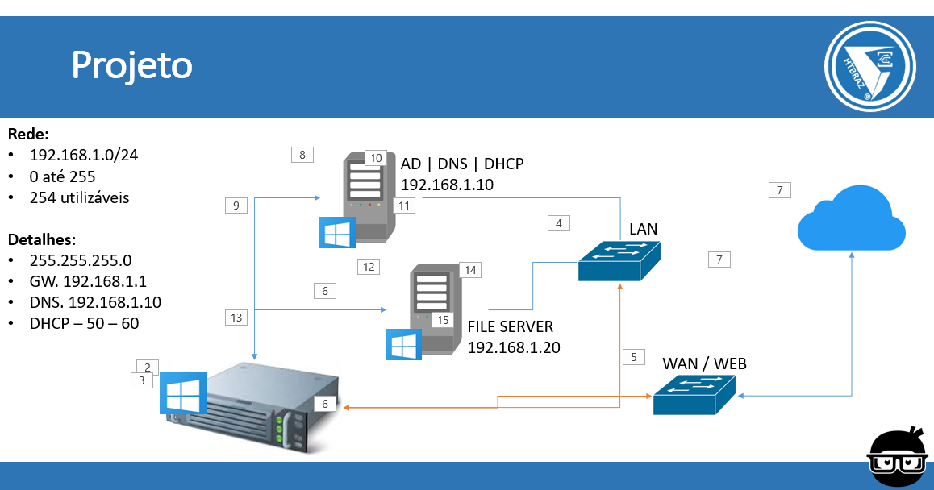
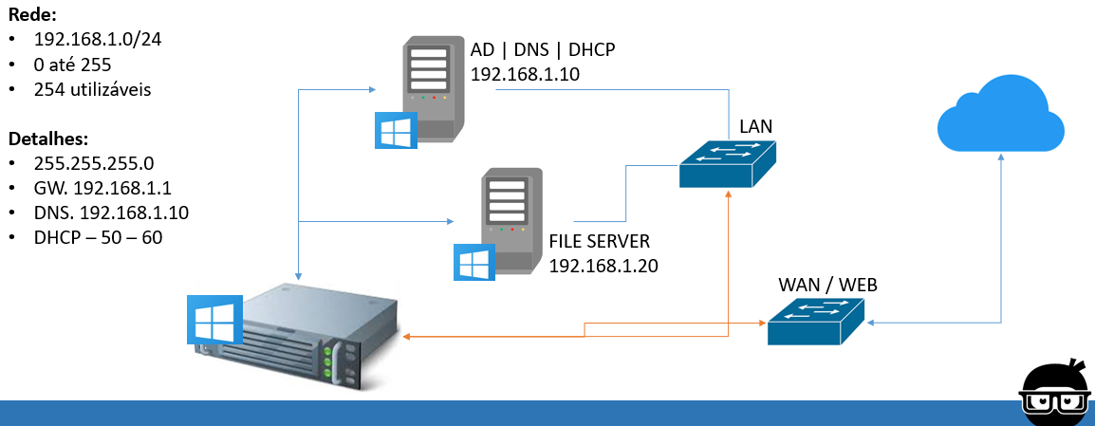
File Server
Boas práticas em gestão de arquivos
Administração de servidores de arquivos
Refinamento de técnicas de gestão de arquivos
Desenho e projeto de ambientes

Slide 95
Técnicas
Agrupamento de permissões [Grupos do ADDS]
Permissões de arquivos e pastas
Compartilhamento de arquivos
Gestão de discos
Configuração de desduplicação de dados
Utilização do ISCSI
Windows DFS
Gestão de cópia de arquivos [Backup]
Failover Cluster com File Server [Share Folder]

Slide 96
FILE SERVER
BOAS PRÁTICAS
ADMINISTRAÇÃO
www.eduardopopovici.com
EDUARDO POPOVICI

Slide 97
SERVIDORES DE ARQUIVOS
Conceitos

Slide 98
File Server
Alto volume de acessos
Crítico para o negócio
Alto volume de armazenamento
Rotinas de backup
Alvo preferido de ataques com ransomware

Slide 99
FILE SERVER
BOAS PRÁTICAS
ADMINISTRAÇÃO
www.eduardopopovici.com
EDUARDO POPOVICI

Slide 100
SERVIDORES DE ARQUIVOS
Conceitos

Slide 101
File Server
Servidores Físicos
Servidores Virtuais
Ambientes em Cloud
Azure
Google Cloud
Amazon

Slide 102
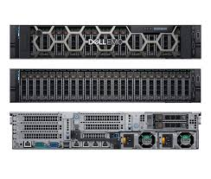
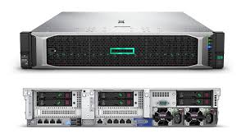
Servidor Físico

Slide 103
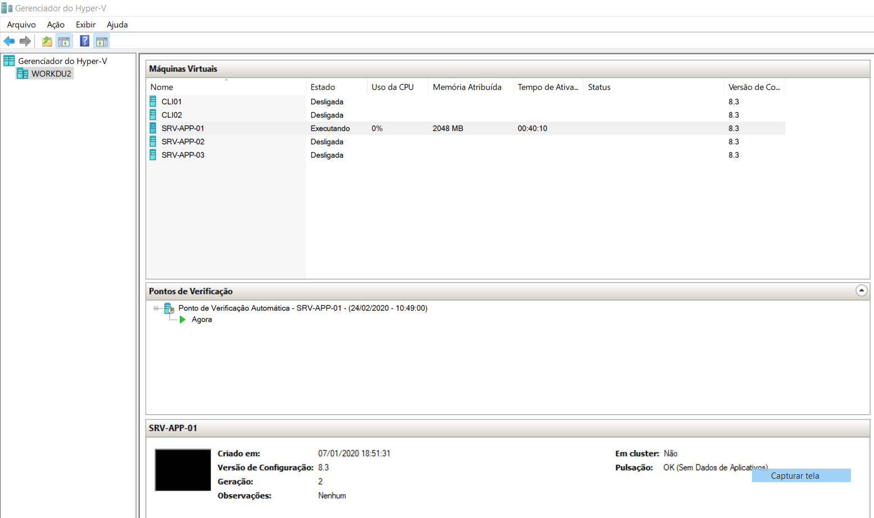
Virtual

Slide 104
FILE SERVER
BOAS PRÁTICAS
ADMINISTRAÇÃO
www.eduardopopovici.com
EDUARDO POPOVICI

Slide 105
PROJETO
Conceitos

Slide 106




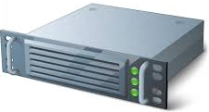
Projeto
Rede:
192.168.1.0/24
0 até 255
254 utilizáveis
Detalhes:
255.255.255.0
GW. 192.168.1.1
DNS. 192.168.1.10
DHCP – 50 – 60
AD | DNS | DHCP
192.168.1.10
LAN
FILE SERVER
192.168.1.20
WAN / WEB

Slide 107
FILE SERVER
BOAS PRÁTICAS
ADMINISTRAÇÃO
www.eduardopopovici.com
EDUARDO POPOVICI

Slide 108
COMUTADORES VIRTUAIS
Conceitos

Slide 109
Virtual Switchs
Externo
Tem acesso a rede física
Interno
Só pode ser usado pelas máquinas virtuais e pelo servidor físico (host).
Particular
Permite que as máquinas virtuais (guest) falem entre si apenas neste servidor físico (host).

Slide 110


Projeto
Externo
Interno
GW

Slide 111
DNS
Conceitos

Slide 112

Resolução de nomes
DNS
Nome para endereço IP
DNS Reverso
Endereço IP para nome
Zonas de DNS
Áreas endereçáveis

Slide 113
Servidores de DNS
Autoritativos
Recursivos

Slide 114
O que é o DNS ?
O DNS (Domain Name System) é um sistema de gerenciamento de nomes hierárquico e distribuído para computadores, serviços ou qualquer recurso conectado à Internet ou em uma rede privada.
Ele se baseia em nomes hierárquicos e permite a inscrição de vários dados digitados além do nome do host e seu endereçamento IP.
Os servidores DNS padrão utilizam a porta 53.

Slide 115
O que é o DNS ?
O papel do DNS é o de converter nomes para endereçamentos IP, sejam eles de categoria 4 (IPV4) ou de categoria 6 (IPV6).
Em uma infraestrutura de redes LAN, é aconselhável trabalhar sempre com pelo menos dois servidores de DNS, sendo um primário e outro secundário.
Este modelo pode evoluir brutalmente dependendo da necessidade e tamanho da infraestrutura e parque de estações de trabalho.

Slide 116
O que é o DNS ?
Em um ambiente onde exista servidores de mensageira (e-mail), é necessário ainda a preocupação com o DNS Reverso.
Seu papel é o de ofertar algo contrário ao do DNS padrão, pois em vez de conectar um nome a um endereçamento IP, ele conecta um endereçamento IP a um nome de domínio.
Também é muito utilizado para configurações chamadas relações de confiança entre domínios (Trusts).

Slide 117
Registros de DNS
Registros A:
Basicamente, associam um ou mais endereços IP a um ou mais domínios. Pode-se utilizar AAAA para endereços IPv6;
Registros CNAME (Canonical Name):
Servem para criar redirecionamentos para domínios ou subdomínios. É este parâmetro que dever ser utilizado, por exemplo, para criar um endereço do tipo blog ou e-mail em seu site. Esta entrada é também conhecida como apelido, pois pode adicionar um segundo ou terceiro nome a um servidor ou equipamento host em uma rede;

Slide 118
Registros de DNS
Registros MX (Mail Exchanger):
São os parâmetros que devem ser configurados para contas de e-mail no domínio. São utilizados a priori por empresas que possuam o Exchange instalado e configurado. Dependendo do tamanho da infraestrutura de redes, é possível encontrar diversas entradas MX, trabalhando tanto com servidores primários quanto servidores secundários;
Registros NS (Name Server):
Indicam quais servidores atuam como serviço de DNS dentre de uma rede ou de um site.
Registros PTR (Pointer):
Informam quais domínios estão associados a determinados IPs, quase se fosse o reverso dos registros A.

Slide 119
Registros de DNS
Registros SRV (abreviação de Service):
Indicam a localização de determinados serviços dentro do domínio;
Registros SOA (Start of Authority):
Indicam o início de uma zona, isto é, de um conjunto de registros localizado dentro de um espaço de nomes de DNS. Cada zona deve ter um registro SOA;
Registros TXT (abreviação de Text):
Servem para a inserção de comentários, porém também servem para validação de servidores de disparo de e-mail pela linha de SPF, por exemplo. Quando disparamos e-mails a uma empresa, é verificado a linha de SPF com dados relacionados a quem disparou o e-mail. Se os dados baterem a mensagem é entregue a seu destinatário, se não ela é descartada ou encaminhada ao lixo eletrônico.

Slide 120
FILE SERVER
BOAS PRÁTICAS
ADMINISTRAÇÃO
www.eduardopopovici.com
EDUARDO POPOVICI

Slide 121
GERENCIAMENTO DE DISCOS
Conceitos

Slide 122
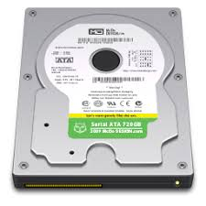
Aumento de disponibilidade
RAID-1
RAID-5

Slide 123


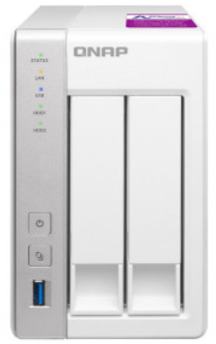
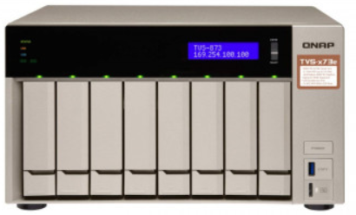
Aumento de disponibilidade

Slide 124
FILE SERVER
BOAS PRÁTICAS
ADMINISTRAÇÃO
www.eduardopopovici.com
EDUARDO POPOVICI

Slide 125
WINDOWS INSIDER
Conceitos

Slide 126
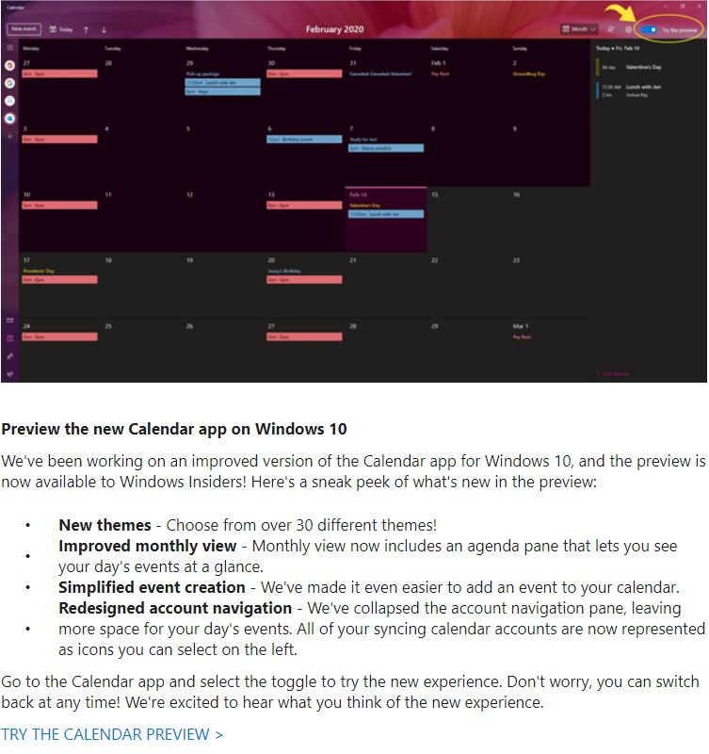


Slide 127
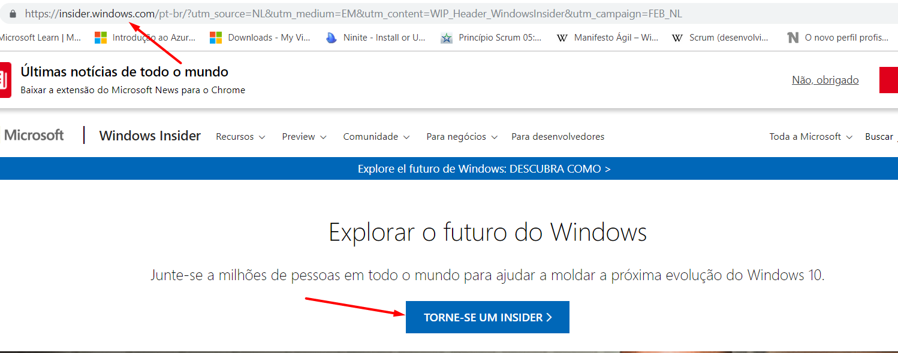

Windows Insider

Slide 128
FILE SERVER
BOAS PRÁTICAS
ADMINISTRAÇÃO
www.eduardopopovici.com
EDUARDO POPOVICI

Slide 129
DFS
Projeto

Slide 130


Projeto – DFS GROUP SERVER
SRV-APP-01
192.168.1.x/24
SRV-APP-02
SRV-APP-03

Slide 131
FILE SERVER
BOAS PRÁTICAS
ADMINISTRAÇÃO
www.eduardopopovici.com
EDUARDO POPOVICI

Slide 132
FAILOVER CLUSTER
Projeto

Slide 133


Projeto – CLUSTER-FS-01
quorum
dados
SRV-APP-01
192.168.1.x/24
quorum
dados
quorum
dados
SRV-APP-02
172.16.40.x/24
SRV-APP-03

Slide 134


Obrigado!!!

